Slide 1
FORT HAMILTON MST SUMMER CAMP (Grades 6-12)
FORT HAMILTON YOUTH CENTER
BUILDING 412, STERLING DRIVE
USAG FORT HAMILTON NY
PHN: (718) 630-4518

Slide 2
MST SUMMER OVERVIEW:
Hours of Operation: 13:00-17:30 M-F
Extended hours for field trip days and special events.
Field Trip Days:
Field trip days and locations are subject to change, advance notice will be provided to patrons
Youth Center field trips and special events require advanced registration and payment, if fees are applicable.
Patrons have until one week prior to special event or field trip to sign up, unless otherwise specified on permission slip.
No refunds will be issued after the sign up cutoff date, as specified on the permission slip, unless extenuating circumstances are discussed with Youth Center Facility Director and the CYS Coordinator.
Absolutely no refunds will be issued on same-day cancellations for trips or special events. If patrons are repeatedly no-shows on days of free trips, the Youth Center Facility Director has the right to not allow youth to sign up for free trips in the future.
Tuesdays: On post outings; Fort Hamilton Bowling Center, Taylor Field, Fort Hamilton Community Club Pool
Thursdays: Large Field Trip (off post)
Fridays: Movie screening at the Fort Hamilton Theater 18:30-21:00

Slide 3
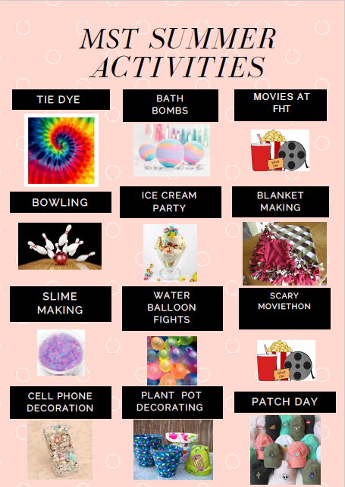

Slide 4
MST TRIPS & SPECIAL EVENTS **Field trip days and locations are subject to change, advance notice will be provided to patrons, return times & prices for off post field trips will be posted at the time of the permission slip release
On Post Tuesdays 15:00-17:00 | Off Post Thursdays | FHYC Special Activities (during regular program hours) | FHT Friday Nights 18:30-21:00 | FHYC Saturday Special Events 14:00-22:00
July 5th: FHBC Bowling | July 7th: Shore Road Excursion14:00 | Tie Dye | July 8th: Avatar | July 9th: Red, White & Glow Party at FHYC
July 12th: FHCC Swimming | July 14th: Museum of Ice Cream 09:00 | Ice Cream Party | July 15th: Black Panther
July 19th: FHBC Bowling | July 21st: Lion King 20:00 | Blanket Making | July 22nd: Hamilton | July 23rd: Alice & Wonderland Tea Party
July 26th: FHCC Swimming | July 28th: Nickelodeon Universe Theme Park 10:30 | Slime Making | July 29th: In the Heights
August 2nd: FHBC Bowling | August 4th: Frog Falls 09:00 | Cell Phone Decoration | August 5th: Godzilla: King of the Monsters | August 6th: Luau Party
August 9th: FHCC Swimming | August 11th: Sea Life 09:00 | Water Balloon Fights | August 12th: I am Legend
August 16th: FHBC Bowling | August 18th: Liberty Science Center 09:00 | Bath Bombs | August 19th: The Quiet Place | August 20th: 70’s Disco Murder Mystery Dinner Party
August 23: FHCC Swimming | August 25th: Prospect Park Zoo 09:00 | Plant Pot Decorating | August 26th: Hansel & Gretel
August 30th: FHBC Bowling | September 1st: Museum of Natural History 09:00 | Patch Day | September 2nd: Avengers | September 3rd – September 4th: Lock In 18:00-07:00

