Slide 1
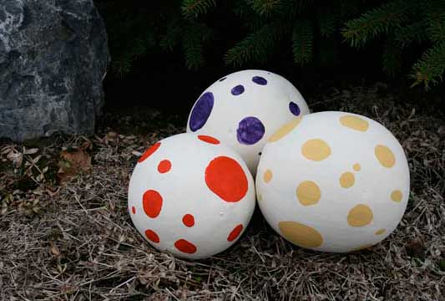
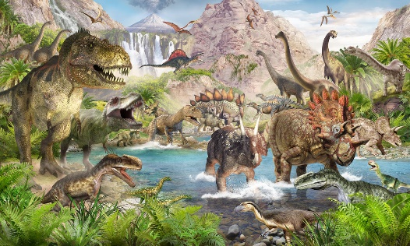
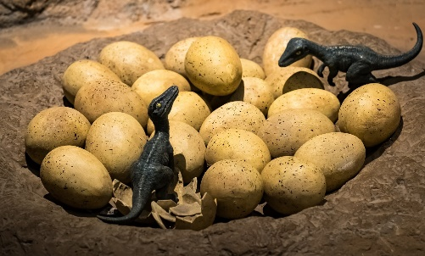
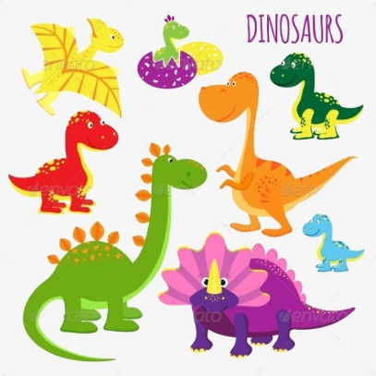
CYS Dino Egg Hunt
Parents Joint CYS for a Dino Egg Hunt at CDC
April 28th @ 1500
218 Marshall Drive
Playgrounds

