Slide 1
FORT HAMILTON SAC SUMMER CAMP (Grades K-5)
FORT HAMILTON YOUTH CENTER
BUILDING 412, STERLING DRIVE
USAG FORT HAMILTON NY
PHN: (718) 630-4518

Slide 2
SAC SUMMER CAMP OVERVIEW:
Hours of Operation: Camp 08:30 - 16:00
Wrap Around Care is 06:30 - 17:30
Field Trip Days:
Weekly spaces that are not paid in full prior to the Monday before the selected camp weeks, will be offered to the next family on the waitlist Tuesday morning and will not be held
Field trip days and locations are subject to change, advance notice will be provided to patrons
Tuesdays: Large Field Trip (off post)
Thursdays: On post outings; Fort Hamilton Bowling Center, Taylor Field, Fort Hamilton Community Club Pool (grades 1-5), Water Play for Kinders at SAC
Fridays: Movie screening at the Fort Hamilton Theater.
Parents must pick up from here NLT 17:30

Slide 3
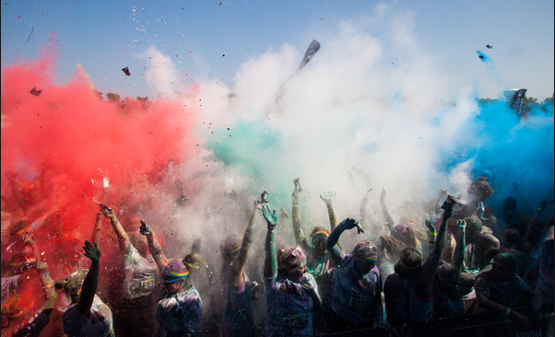
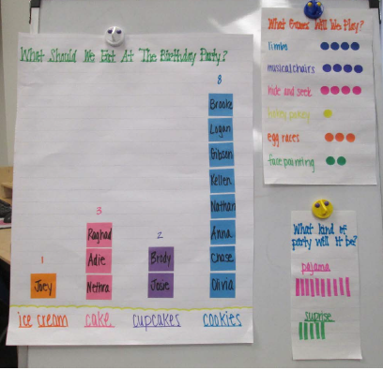
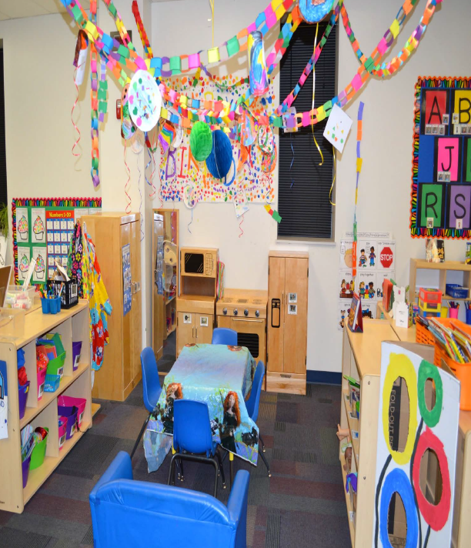
WEEK 1: PARTY IN THE USA (July 4)
Monday 7/4/2022 | Tuesday 7/5/2022 | Wednesday 7/6/2022 | Thursday 7/7/2022 | Friday 7/8/2022
CLOSED | 11:00 BBQ @ Taylor Field | 10:00 Color Run | 15:00 Bowling Center | 15:00 FHT
Dramatic play will be transformed into a birthday party (curriculum and activities throughout the day focus on literacy, math, STEM, and social skills enhanced through play)
Spotlight Activity Cooking Project: Red, White, & Blue fruit kabobs
Spotlight Activity : BBQ/ Picnic on Taylor Field
Spotlight Activity : Red, White, & Blue Color Run
Red, White, & Bowling at Fort Hamilton Bowling Center
Feature Friday: The American Tail screening at the Fort Hamilton Theater

Slide 4
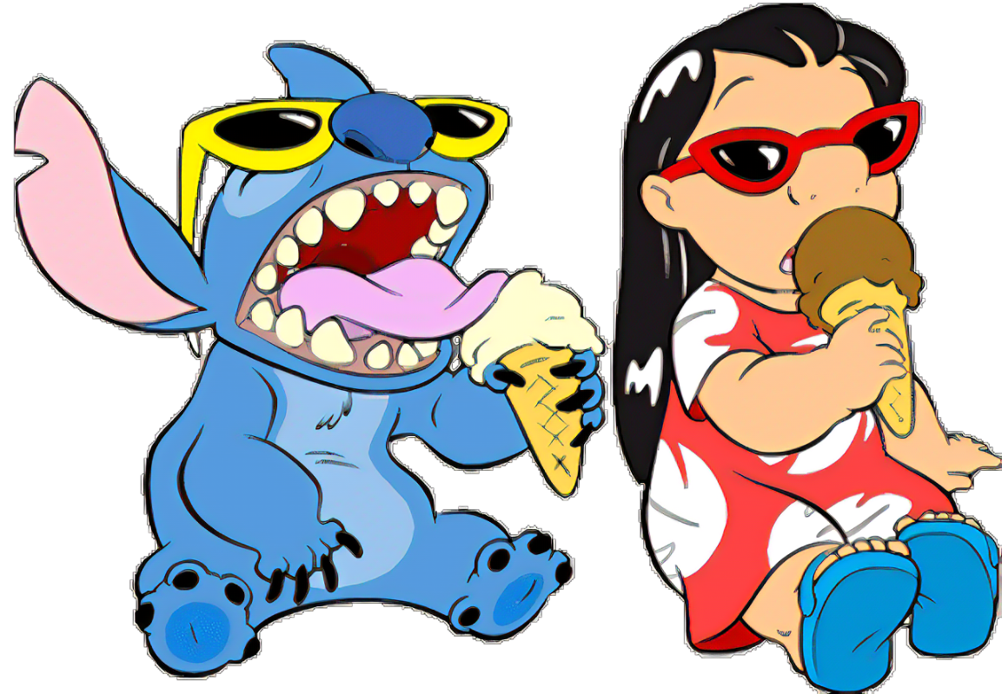
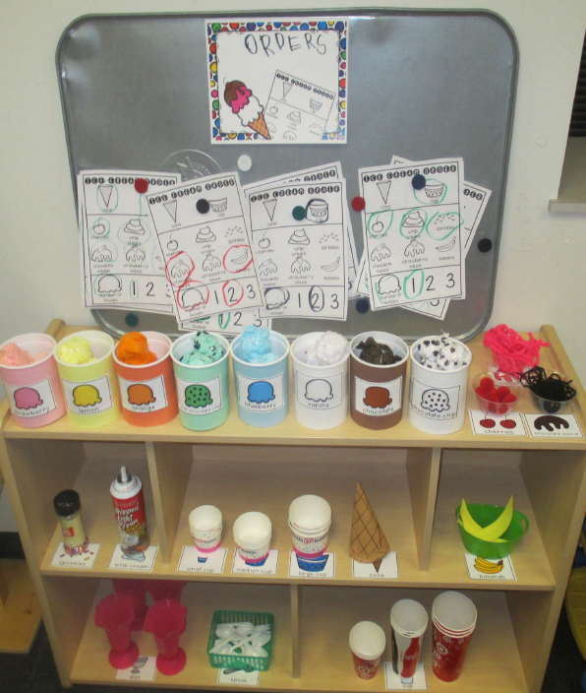
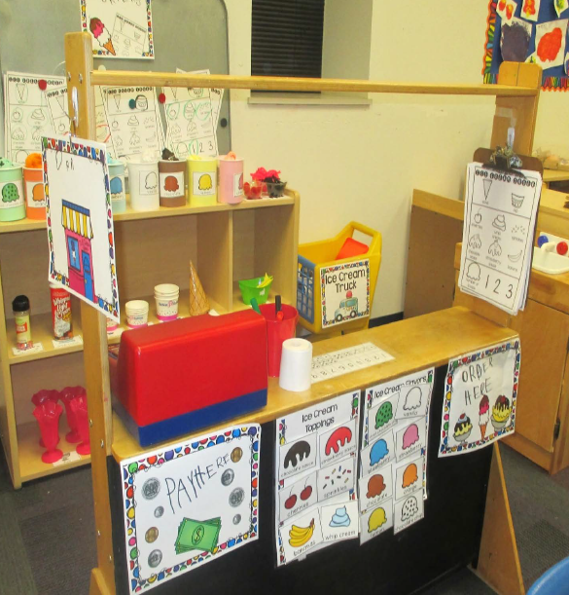
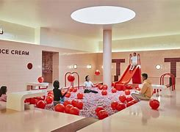
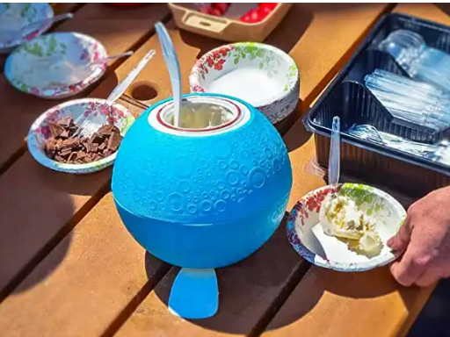
WEEK 2: WE ALL SCREAM FOR ICE CREAM (July 11)
Monday 7/11/2022 | Tuesday 7/12/2022 | Wednesday 7/13/2022 | Thursday 7/14/2022 | Friday 7/15/2022
Cooking Project | 09:00 Depart for MoIC | Snow Cone Party | 15:00 Swimming at FHCC | 15:00 FHT
Dramatic play will be transformed into an ice-cream shop (curriculum and activities throughout the day focus on literacy, math, STEM, and social skills enhanced through play)
Spotlight Activity: Cooking Project: Ice Cream Soccer Ball
Spotlight Activity: Snow Cone Party
Field Trip: Museum of Ice Cream
Feature Friday: Lilo & Stitch on the BIG screen

Slide 5
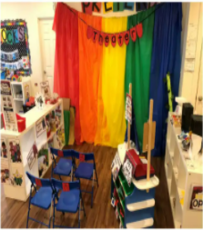
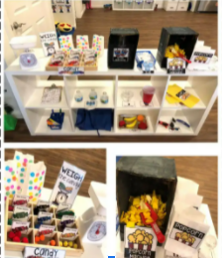
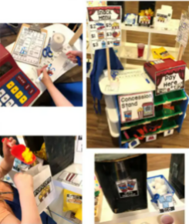
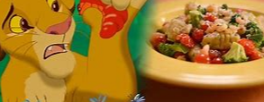
WEEK 3: HAKUNA MATATA (July 18)
Monday 7/18/2022 | Tuesday 7/19/2022 | **Wednesday 7/20/2022 | Thursday 7/21/2022 | Friday 7/22/2022
Cooking Project | Play Practice | **12:30 Depart for Lion King | 15:00 Bowling Center | 15:00 FHMT SAC Production
Dramatic play will be transformed into a theater (curriculum and activities throughout the day focus on literacy, math, STEM, and social skills enhanced through play)
Cooking Project: Simba’s Slimy Grub Gnocchi
Fieldtrip: Lion King on Broadway **WEDNESDAY Field Trip** LATE RETURN
Feature Friday: Children will put on a production at the Fort Hamilton Theater
Parents invited to attend

Slide 6
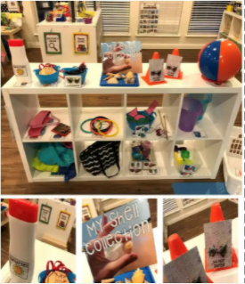
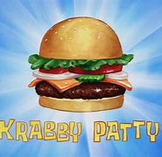
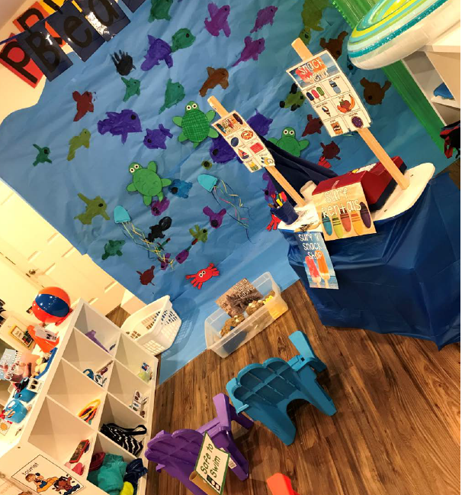
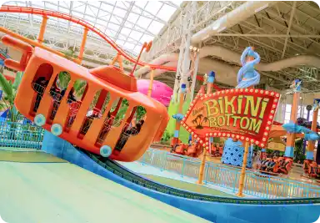
WEEK 4: SLIME TIME (July 25)
Monday 7/25/2022 | Tuesday 7/26/2022 | Wednesday 7/27/2022 | Thursday 7/28/2022 | Friday 7/29/2022
Cooking Project | 10:30 Depart to Nickelodeon | Slime Spectacular | 15:00 Swimming at FHCC | 15:00 FHMT
Dramatic play will be transformed into the beach (curriculum and activities throughout the day focus on literacy, math, STEM, and social skills enhanced through play)
Spotlight Activity Cooking Project: Krabby Patty
Fieldtrip : Nickelodeon Universe Theme Park
Spotlight Activity: Slime Spectacular (children will make all different kinds of slime, and have a chance to slime the staff)
Feature Friday: The Spongebob Movie presented at the FH Theater

Slide 7
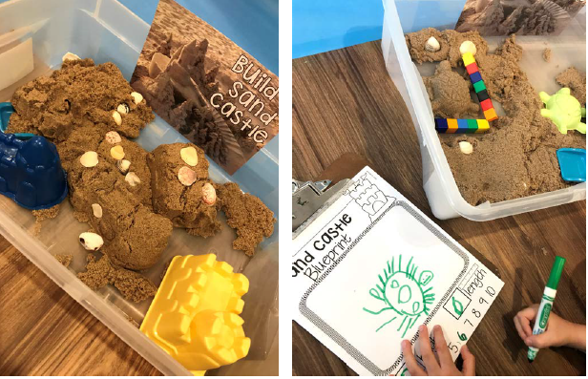
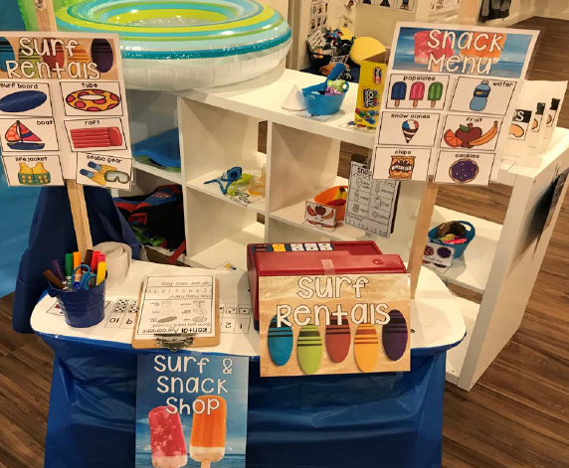
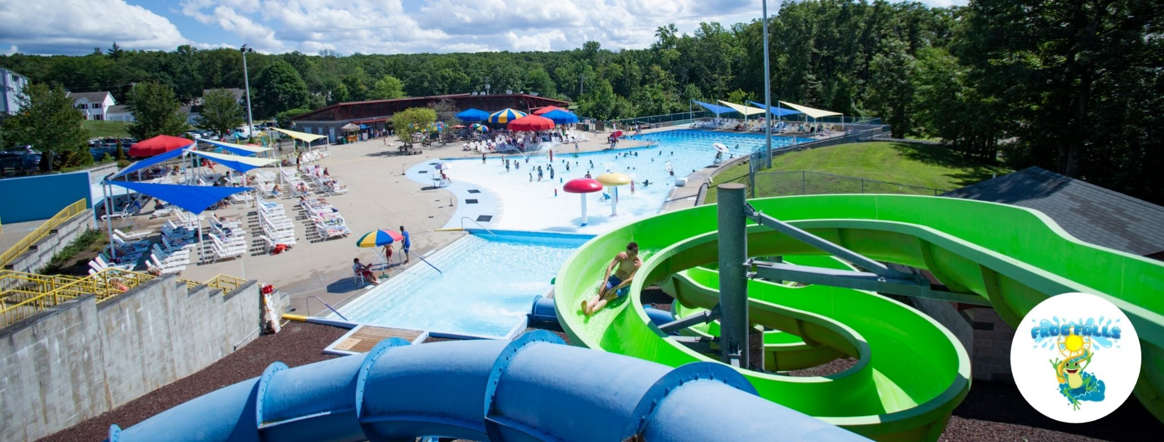
WEEK 5: UNDERWATER EXPLORATION (Aug 1)
Monday 8/1/2022 | Tuesday 8/2/2022 | Wednesday 8/3/2022 | Thursday 8/4/2022 | Friday 8/5/2022
Cooking Project | 09:00 Depart to Frog Falls | MWR Fitness Class | 15:00 Bowling Center | 15:00 FHT
Dramatic play will be transformed into the beach (curriculum and activities throughout the day focus on literacy, math, STEM, and social skills enhanced through play)
Spotlight Activity Cooking Project: Fruit Smoothies
Spotlight Activity Guest Visitor: MWR fitness instructor
Spotlight Activity Large Dance-Dance Revolution set up in the gym.
Field Trip: Frog Falls, Picatinny Arsenal
Feature Friday: Moana- big screen viewing at Fort Hamilton Theater

Slide 8
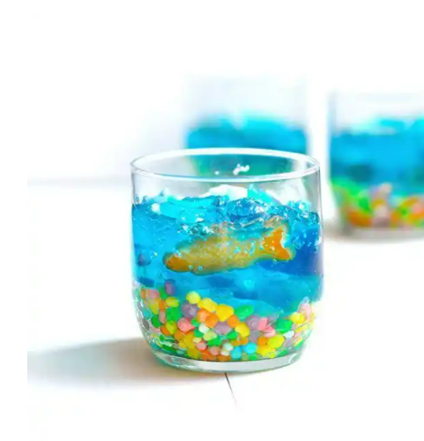
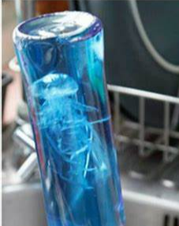
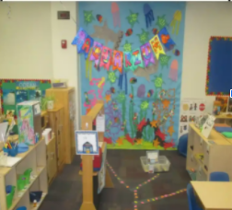
WEEK 6: JUST KEEP SWIMMING (Aug 8)
Monday 8/8/2022 | Tuesday 8/9/2022 | Wednesday 8/10/2022 | Thursday 8/11/2022 | Friday 8/12/2022
Cooking Project | 09:00 Depart to Sea Life | Jellyfish Sensory Bottles | 15:00 Swimming at FHCC | 15:00 FHMT
Dramatic play will be transformed into an aquarium (curriculum and activities throughout the day focus on literacy, math, STEM, and social skills enhanced through play)
Cooking Project: Jello Aquarium
Field Trip: Sea Life
Feature Friday: Finding Nemo- big screen viewing at Fort Hamilton Theater

Slide 9
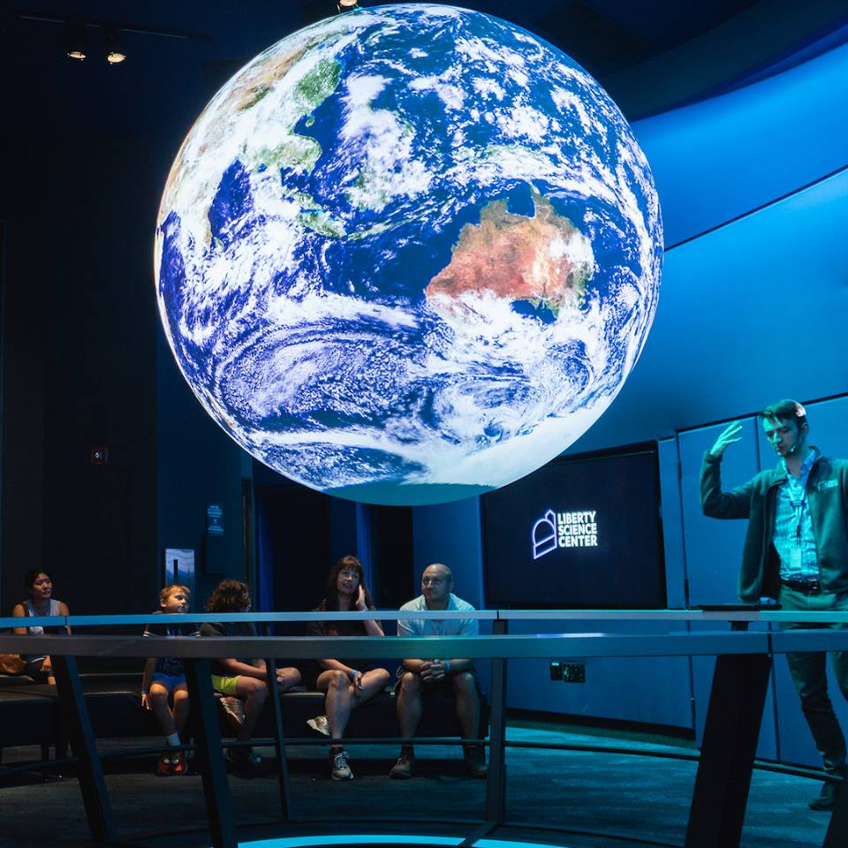
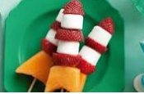
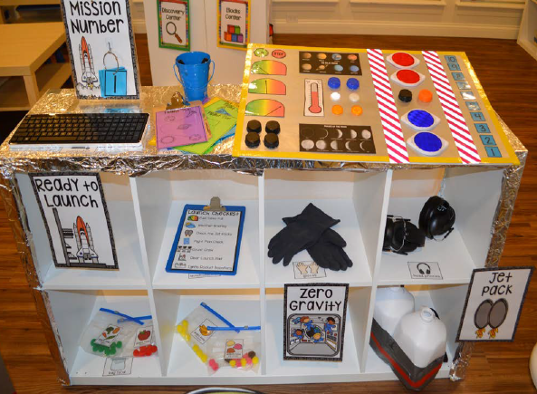
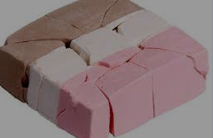
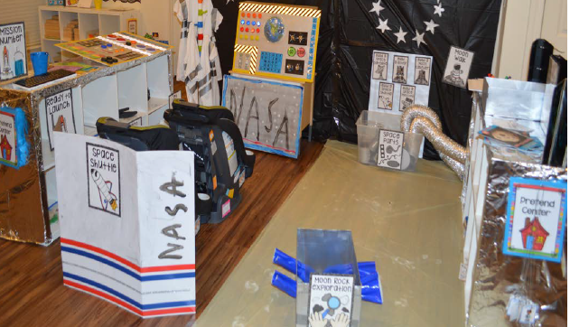
WEEK 7: TO INFINITY & BEYOND (Aug 15)
Monday 8/15/2022 | Tuesday 8/16/2022 | Wednesday 8/17/2022 | Thursday 8/18/2022 | Friday 8/19/2022
Cooking Project | 09:00 Depart to LSC | Virtual Fieldstrip of the ISS | 15:00 Bowling Center | 15:00 FHMT
Dramatic play will be transformed into a space station (curriculum and activities throughout the day focus on literacy, math, STEM, and social skills enhanced through play)
Cooking Project: Rock melon & strawberry rockets, astronaut ice-cream
Fieldtrip: Liberty Science Center
Cosmic Bowling FH Bowling Center
Feature Friday: Toy Story BIG screen viewing at FHT

Slide 10
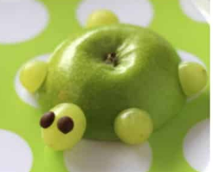
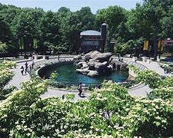
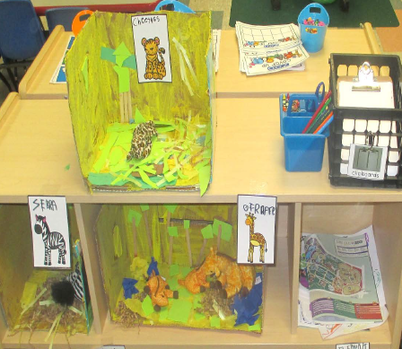
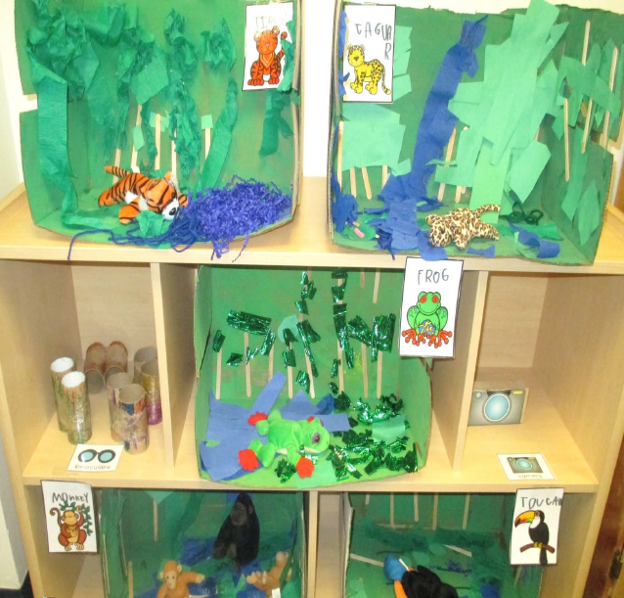
WEEK 8: ANIMAL KINGDOM (Aug 22)
Monday 8/22/2022 | Tuesday 8/23/2022 | Wednesday 8/24/2022 | Thursday 8/25/2022 | Friday 8/26/2022
Cooking Project | 09:00 Depart to PPZ | Kidz Bop Karaoke | 15:00 Swimming at FHCC | 15:00 FHT
Dramatic play will be transformed into a zoo (curriculum and activities throughout the day focus on literacy, math, STEM, and social skills enhanced through play)
Cooking Project: Animal cookies, apple turtles
Kidz Bop Karaoke
Fieldtrip: Prospect Park Zoo
Feature Friday: Madagascar viewing on the BIG screen at Fort Hamilton Theater

Slide 11
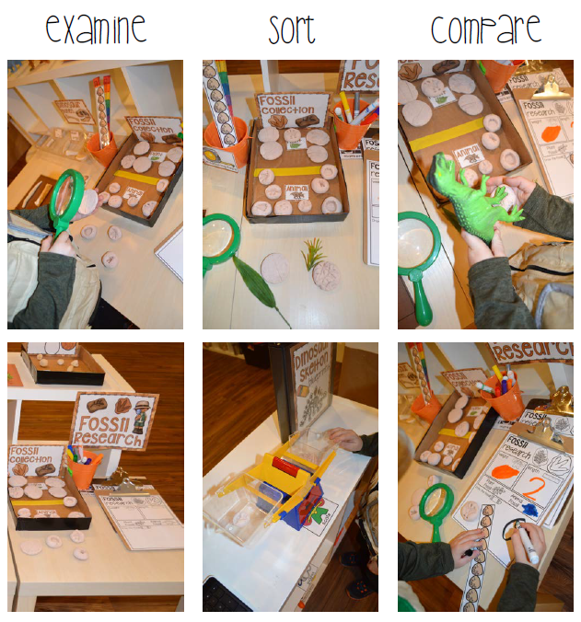
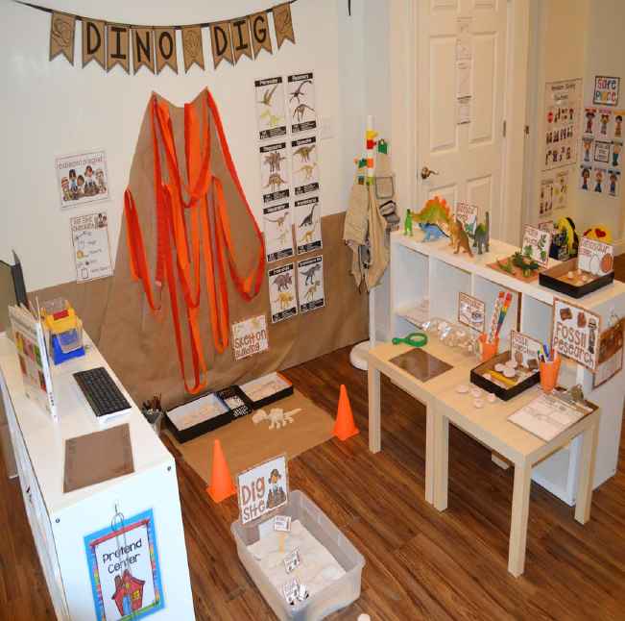
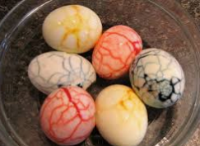
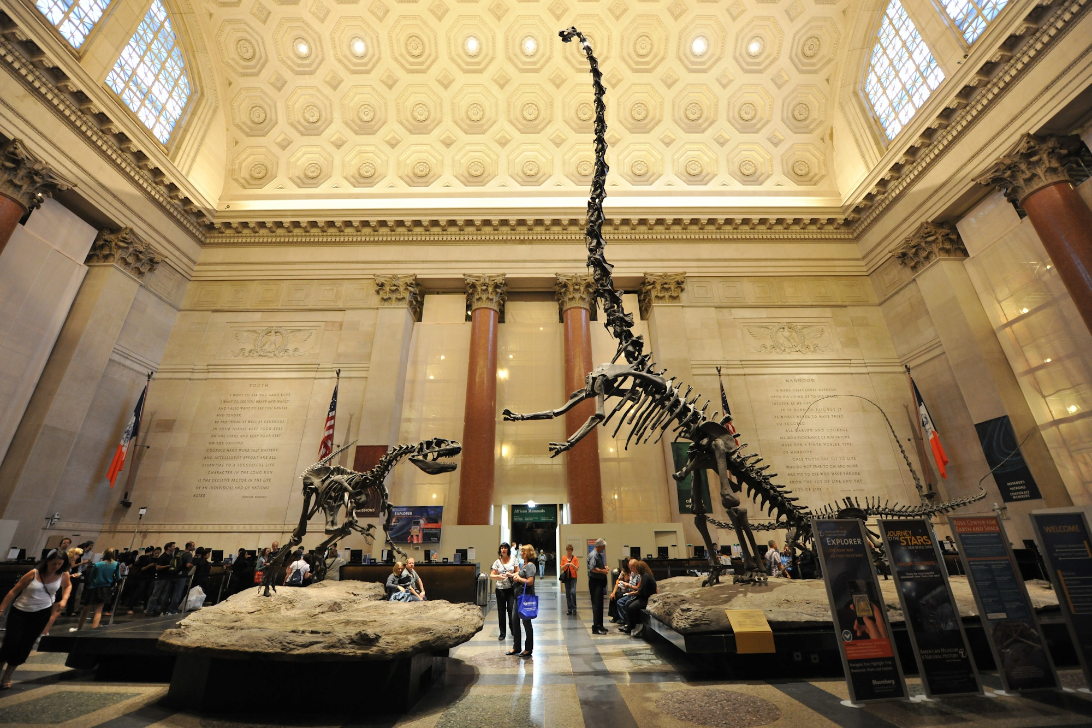
WEEK 9: DIGGIN’ UP DINOS (Aug 29)
Monday 8/29/2022 | Tuesday 8/30/2022 | Wednesday 8/31/2022 | Thursday 9/1/2022 | Friday 9/2/2022
Cooking Project | 09:00 Depart to MoNH | Excavating Extravaganza | 15:00 Bowling Center | 15:00 FHT
Dramatic play will be transformed into a dino dig (literacy, math, and social skills enhanced through play)
Cooking Project: Dino Eggs
Fieldtrip: Museum of Natural History
Feature Friday: We’re Back big screen viewing at Fort Hamilton Theater

Slide 12
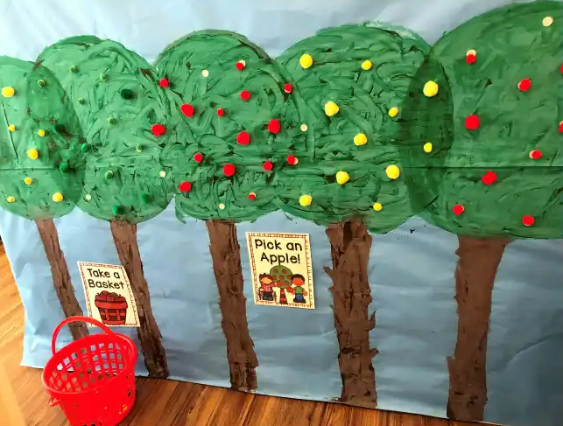
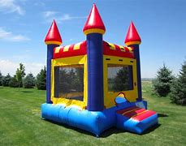
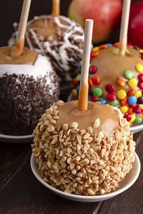
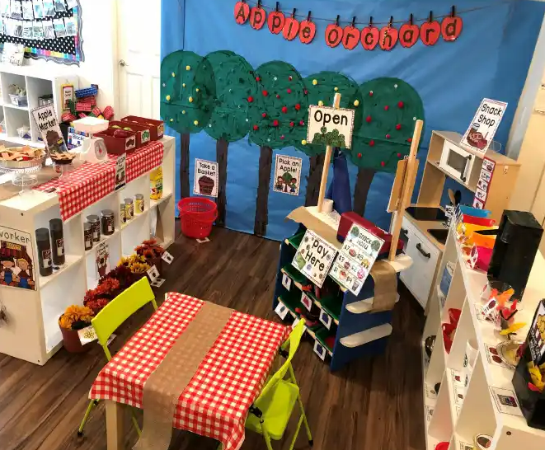
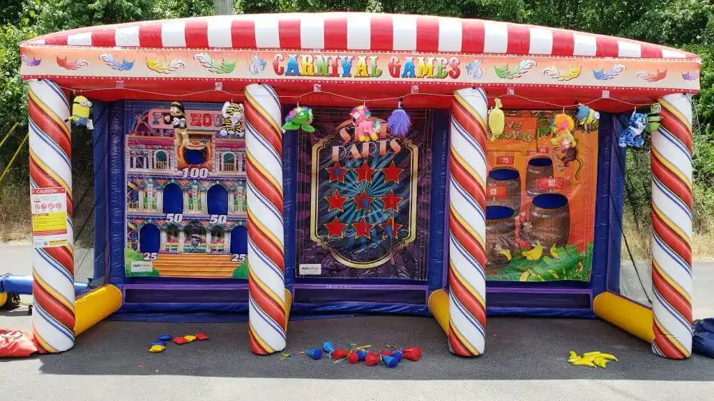
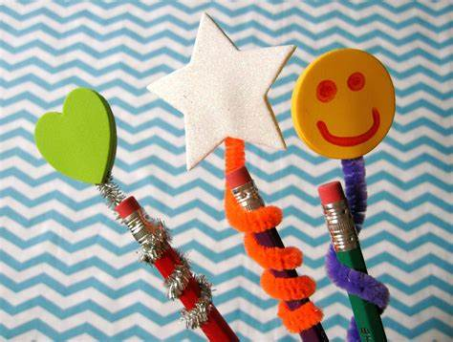
Week 10: BACK TO SCHOOL BASH (Sep. 5)
Monday 9/5/2022 | Tuesday 9/6/2022 | Wednesday 9/7/2022 | Thursday 9/8/2022 | Friday 9/9/2022
CLOSED | Cooking Project | Super School Supplies | “FAIR-well” Summer | 15:00 FHMT
Dramatic play will be transformed into an apple orchard (curriculum and activities throughout the day focus on literacy, math, STEM, and social skills enhanced through play)
Spotlight Activity Cooking Project: Caramel Apples
During our ‘Super School Supplies’ spotlight activity, children will personalize their own composition books, pencil toppers, and make their own crazy crayon,
We will say farewell to summer at our fair featuring bouncy house, face painting, snacks, and various carnival games

