Slide 1
FORT HAMILTON SAC SUMMER CAMP 2023
FORT HAMILTON YOUTH CENTER
BUILDING 412, STERLING DRIVE
USAG FORT HAMILTON NY
PHN: (718) 630-4518

Slide 2
SAC SUMMER CAMP OVERVIEW:
Hours of Operation: Camp 08:30 - 16:00
Wrap Around Care is 06:30 - 17:30
Weekly spaces that are not paid in full prior to the Monday before the selected camp weeks, will be offered to the next family on the waitlist Tuesday morning and will not be held!
Camp weekly themes are based on our five service areas for programming (the arts, health, wellness & life skills, character/leadership development, sports, fitness & recreation and education/leadership exploration).
Curriculum and activities throughout the day focus on literacy, math, STEM, and social skills enhanced through play. Each day will also include “highlight” or special activities.
Weekly schedules will be posted to see what your child will be doing and where they will be during the course of the day!

Slide 3
SAC SUMMER CAMP OVERVIEW:
Meal times
Breakfast: 0800-0830
Lunch: 1100-1130
Snack: 1400-1430

Slide 4
SAC SUMMER CAMP OVERVIEW:
Field Trip Days
Off-Post Field Trips:
Tuesdays
Field trip days and locations are subject to change, advance notice will be provided to patrons.
On-Post Field Trips (1200-1400):
Wednesdays & Thursdays
Fort Hamilton Community Club Pool (Grades 1-5)
Water Play for Kinders at SAC
Fridays
Fort Hamilton Bowling Center

Slide 5
SAC SUMMER CAMP OVERVIEW:
What do I need to provide for my child?
Daily:
sunscreen lotion (aerosol sprays and food-type ingredients are not permitted; must be fragrance-free)
closed-toed shoes for running (no flip-flops, slippers or sandals are permitted)
extra clothing for potential messes
a light sweater for varying weather
For pool & water play:
swimsuit
beach towel
water shoes or crocs (no flip-flops, slippers or sandals)
All items can be packed in a backpack/knapsack that will be held in our locker room during camp.
Outside foods/beverages and personal toys are not permitted into the program!

Slide 6
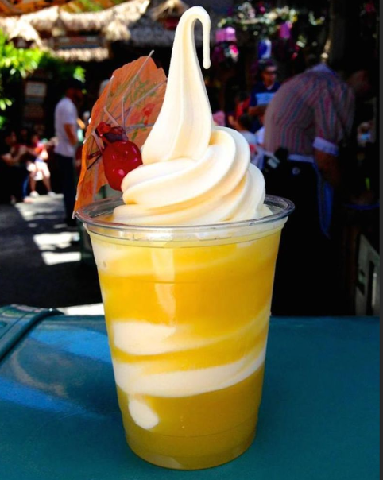
WEEK 1: ALOHA, SUMMER! (July 3-July 7)
Monday 7/3/2023 | Tuesday 7/4/2023 | Wednesday 7/5/2023 | Thursday 7/6/2023 | Friday 7/7/2023
Dole Whip Luau Summer Kick-Off! | CLOSED | Swimming @ FHCC (1-5) WaterPlay (K) | Swimming @ FHCC (1-5) WaterPlay (K) | 1200: Bowling Center Lilo & Stitch
We are kicking off our summer with a big “Aloha” to fun!
Monday
Cooking Project: DIY Dole Whip
Luau Summer Kick-Off @ FHYC Playground!
Tuesday
Happy 4th! No Camp
Wednesday & Thursday
Swimming/Water Play 1200-1400
Friday
Bowling 1200-1400
Movie Feature: “Lilo & Stitch” on the BIG screen

Slide 7
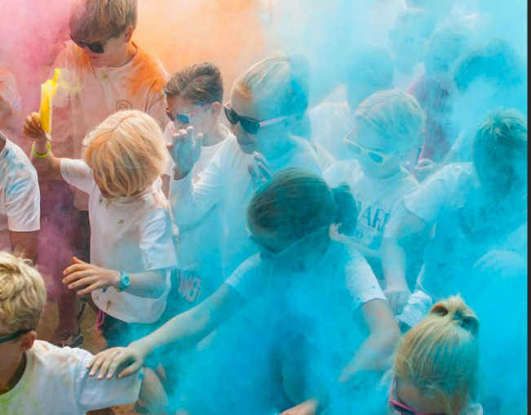
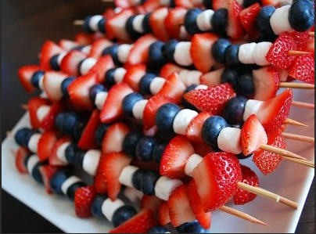
WEEK 2: PARTY IN THE USA (July 10-July 14)
Monday 7/10/2023 | Tuesday 7/11/2023 | Wednesday 7/12/2023 | Thursday 7/13/2023 | Friday 7/14/2023
Red, White & Blue Fruit Kabobs An American Tail | 0900 Depart for Liberty Science Center | Swimming @ FHCC (1-5) Water Play (K) | Swimming @ FHCC (1-5) Water Play (K) | 1200 Bowling Center 1430 Red, White & Blue Color Run
We will be celebrating the 4th, CYS style!
Monday
Cooking Project: Red, White & Blue Fruit Kabobs
Movie Feature: “An American Tail” on the BIG screen
Tuesday
Field Trip Tuesdays: Liberty Science Center (0900 Departure)
Wednesday & Thursday
Swimming/Water Play 1200-1400
Friday
Bowling @ 1200
Red, White & Blue Color Run on Taylor Field @ 1430

Slide 8
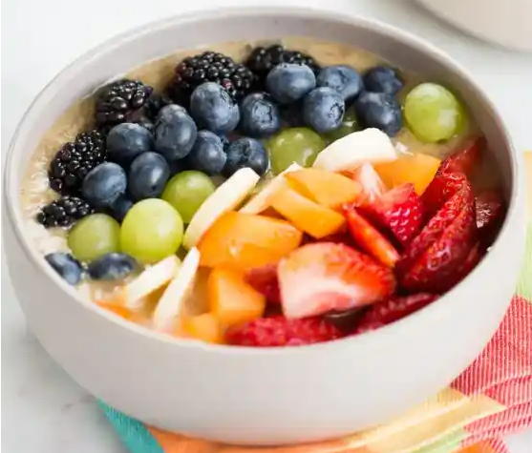
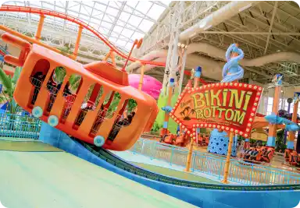
WEEK 3: THE COLOR WAR! (July 17-July 21)
Monday 7/17/2023 | Tuesday 7/18/2023 | **Wednesday 7/19/2023 | Thursday 7/20/2023 | Friday 7/21/2023
Rainbow Smoothie Bowls Inside Out | 1030 Depart for Nickelodeon | Swimming @ FHCC (1-5) Water Play (K) | Swimming @ FHCC (1-5) Water Play (K) | 1200 Bowling Center 1430 Color War - Field Challenge!
Let the games begin! Which color group will come out on top?
Monday
Cooking Project: Rainbow Smoothie Bowls
Movie Feature: “Inside Out” on the BIG screen
Tuesday
Field Trip Tuesdays: Nickelodeon Universe (0900 Departure)
Wednesday/Thursday
Swimming/Water Play 1200-1400
Friday
Bowling @ 1200
Color War - Field Challenge on Taylor Field @ 1430

Slide 9
WEEK 4: SLIME TIME (July 24-July 28)
Monday 7/24/2023 | Tuesday 7/25/2023 | Wednesday 7/26/2023 | Thursday 7/27/2023 | Friday 7/28/2023
Krabby Patties Slime Spectacular! | 0900 Depart for Sloomoo | Swimming @ FHCC (1-5) Water Play (K) | Swimming @ FHCC (1-5) Water Play (K) | 1200 Bowling Center The Spongebob Movie
Sensory Fun!
Monday
Cooking Project: Krabby Patties
Slime Spectacular - Children will create all kinds of slime and will get a chance to slime the staff
Tuesday
Field Trip Tuesdays: Sloomoo Institute (0900 Departure)
Wednesday & Thursday
Swimming/Water Play 1200-1400
Friday
Bowling @ 1200
Movie Feature: “The Spongebob Movie” on the BIG screen

Slide 10
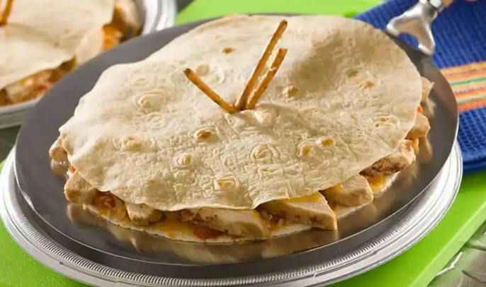
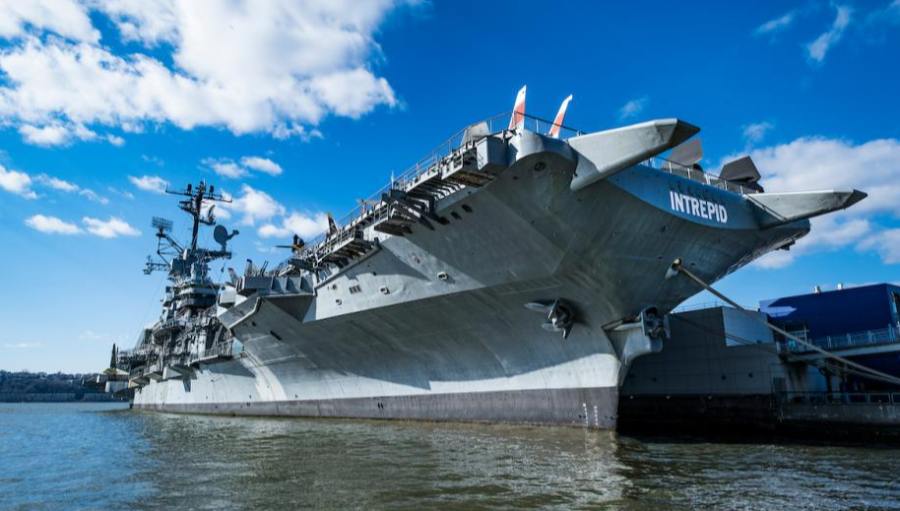
WEEK 5: HERO’S JOURNEY (July 31-August 4)
Monday 7/31/2023 | Tuesday 8/1/2023 | Wednesday 8/2/2023 | Thursday 8/3/2023 | Friday 8/4/2023
Flying Saucer Quesadillas | 1000 Depart to Intrepid Museum | Swimming @ FHCC (1-5) Water Play (K) | Swimming @ FHCC (1-5) Water Play (K) | 1200 Bowling Center Lightyear
We are on a journey to becoming the BEST version of ourselves..
Monday
Cooking Project: Flying Saucer Quesadillas
Tuesday
Field Trip Tuesdays: Intrepid Museum (1000 Departure)
Wednesday/Thursday
Swimming/Water Play 1200-1400
Friday
Bowling @ 1200
Movie Feature: “Lightyear” on the BIG screen

Slide 11
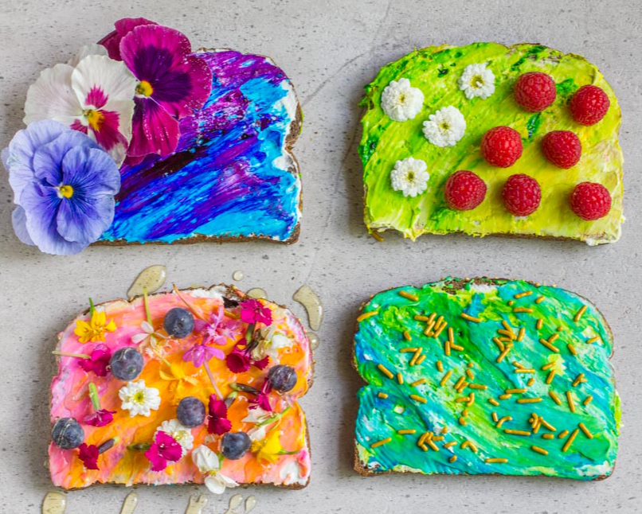
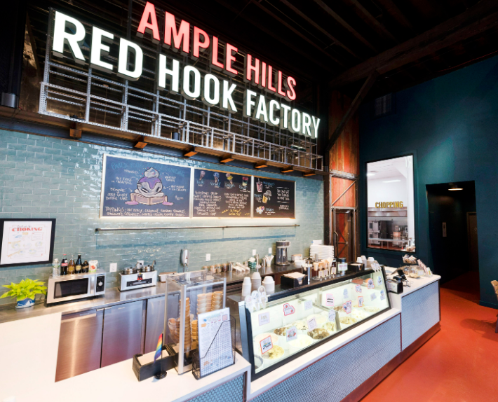
WEEK 6: MASTER CHEFS (August 7-August 11)
Monday 8/7/2023 | Tuesday 8/8/2023 | Wednesday 8/9/2023 | Thursday 8/10/2023 | Friday 8/11/2023
Unicorn Toast | 1200 Depart to Ample Hills Ice Cream Factory | Swimming @ FHCC (1-5) Water Play (K) | Swimming @ FHCC (1-5) Water Play (K) | 1200 Bowling Center Charlie & The Chocolate Factory
Monday
Cooking Project: Unicorn Toast
Tuesday
Field Trip Tuesdays: Ample Hills Ice Cream Factory (1200 Departure)
Wednesday & Thursday
Swimming/Water Play 1200-1400
Friday
Bowling @ 1200
Movie Feature: “Charlie & The Chocolate Factory” on the BIG screen

Slide 12
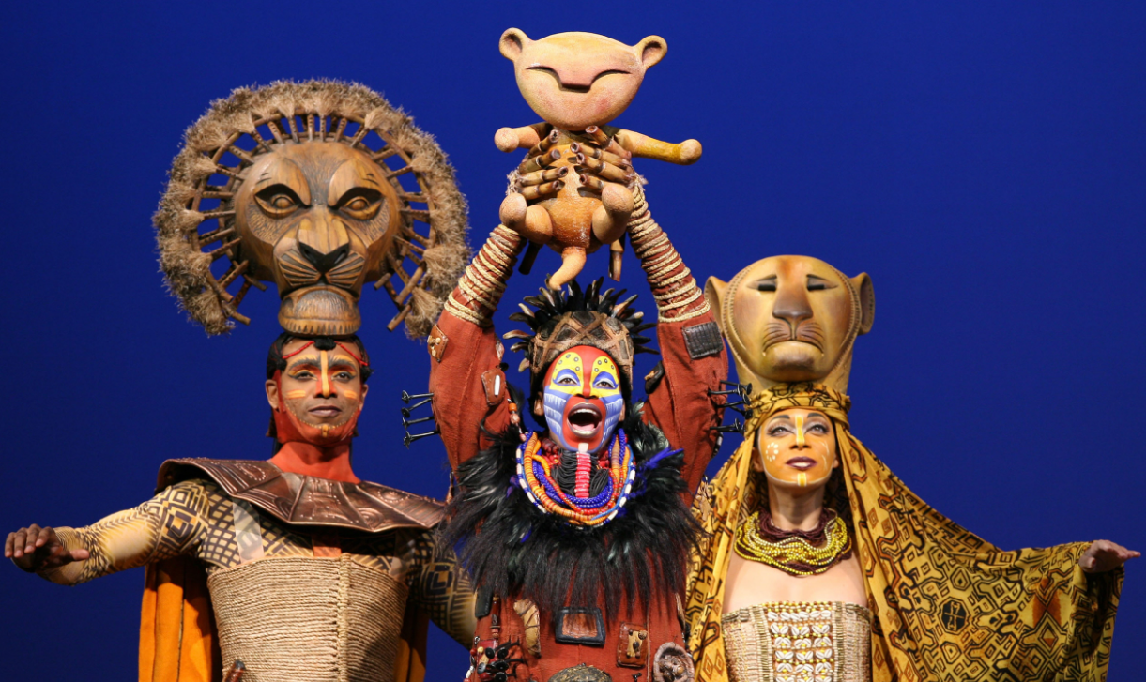
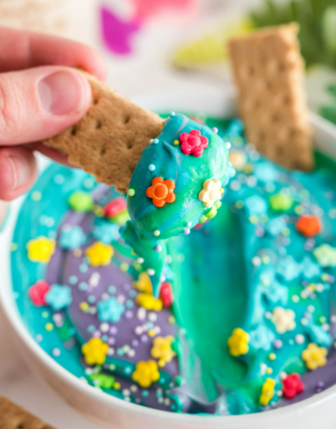
WEEK 7: CYS’S GOT TALENT! (Aug 14-Aug 18)
Monday 8/14/2023 | Tuesday 8/15/2023 | Wednesday 8/16/2023 | Thursday 8/17/2023 | Friday 8/18/2023
Encanto Dip | 1230 Depart to Lion King | Swimming @ FHCC (1-5) Water Play (K) | Swimming @ FHCC (1-5) Water Play (K) | 1200 Bowling Center Sing
Monday
Cooking Project: Encanto Dip
Tuesday
Field Trip Tuesdays: The Lion King on Broadway (1230 Departure)
Wednesday & Thursday
Swimming/Water Play 1200-1400
Friday
Bowling @ 1200
Movie Feature: “Sing” on the BIG screen

Slide 13
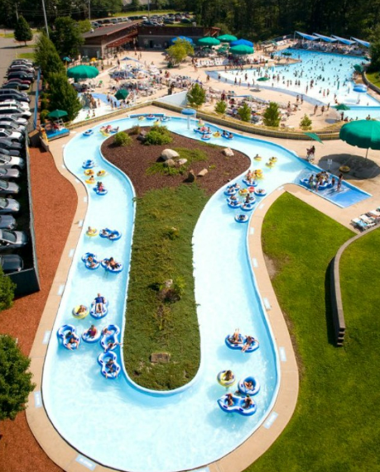
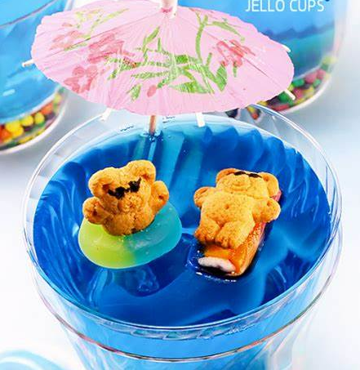
WEEK 8: SPLASH! (Aug 21-Aug 25)
Monday 8/21/2023 | Tuesday 8/22/2023 | Wednesday 8/23/2023 | Thursday 8/24/2023 | Friday 8/25/2023
Beach Day Jello Cups | 0900 Depart to Frog Falls | Swimming @ FHCC (1-5) Water Play (K) | Swimming @ FHCC (1-5) Water Play (K) | 1200 Bowling The Little Mermaid
Monday
Cooking Project: Beach Day Jello Cups
Tuesday
Field Trip Tuesdays: Frog Falls (0900 Departure)
Wednesday & Thursday
Swimming/Water Play 1200-1400
Friday
Bowling @ 1200
Movie Feature: “The Little Mermaid” on the BIG screen

Slide 14
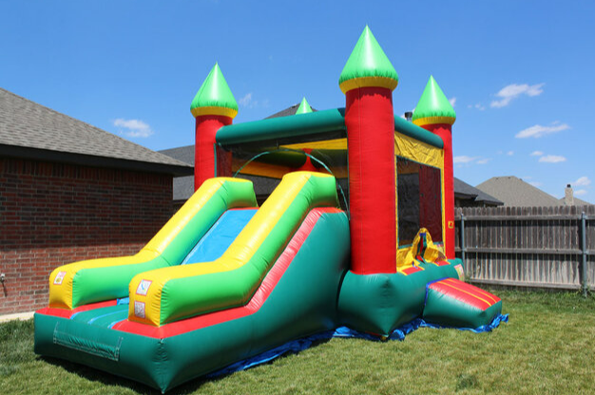
WEEK 9: SUMMER SEND OFF! (Aug 28-Sept 1)
Monday 8/28/2023 | Tuesday 8/29/2023 | Wednesday 8/30/2023 | Thursday 8/31/2023 | Friday 9/1/2023
1500 “FAIR”-Well Summer | 0900 Depart to BX Zoo | Swimming @ FHCC (1-5) Water Play (K) | Swimming @ FHCC (1-5) Water Play (K) | 1200 Bowling Movie - Group Choice!
We will say farewell to summer at our fair featuring bouncy house, face painting, snacks, and various carnival games
Monday & Wednesday
“FAIR”-Well Summer @ the Bluff! 1500-1700
Tuesday
Field Trip Tuesdays: The Bronx Zoo (0900 Departure)
Wednesday & Thursday
Swimming/Water Play 1200-1400
Friday
Bowling @ 1200
Movie Feature: Group Choice! on the BIG screen

